Slide 1
The Semantics of Classifiers in some Indian Languages.
Co Authored By -- Ritesh Kumar , Bornini Lahiri
Sudhanshu Shekhar, Atanu Saha
Presented by--
Atanu Saha
Sudhanshu Shekhar
Center For Linguistics
J.N.U. New Delhi- 67

Slide 2
Introduction
Basically two types of Noun classification System in languages i) Noun Class System ii) Noun Classifier System
Noun Class systen is realized by agrement realations within the sentence.
Noun Classifiers are often independent words and they are independent (lexical items)of any other components of an NP or Clause.
Noun Class Systems are closed and highly grammatical zed obligatory systems realized through affixal agreement

Slide 3
Contd..
example of Noun Class:Hindi
əccʰ-a ləɽk-a (good-AGM boy-AGM)
əccʰ-i ləɽk-i (good –AGM girl-AGM)
In a noun classifier language a noun does not require classifiers mandatorily. Also it is possible that a noun may take different classifiers and denote different meanings.

Slide 4
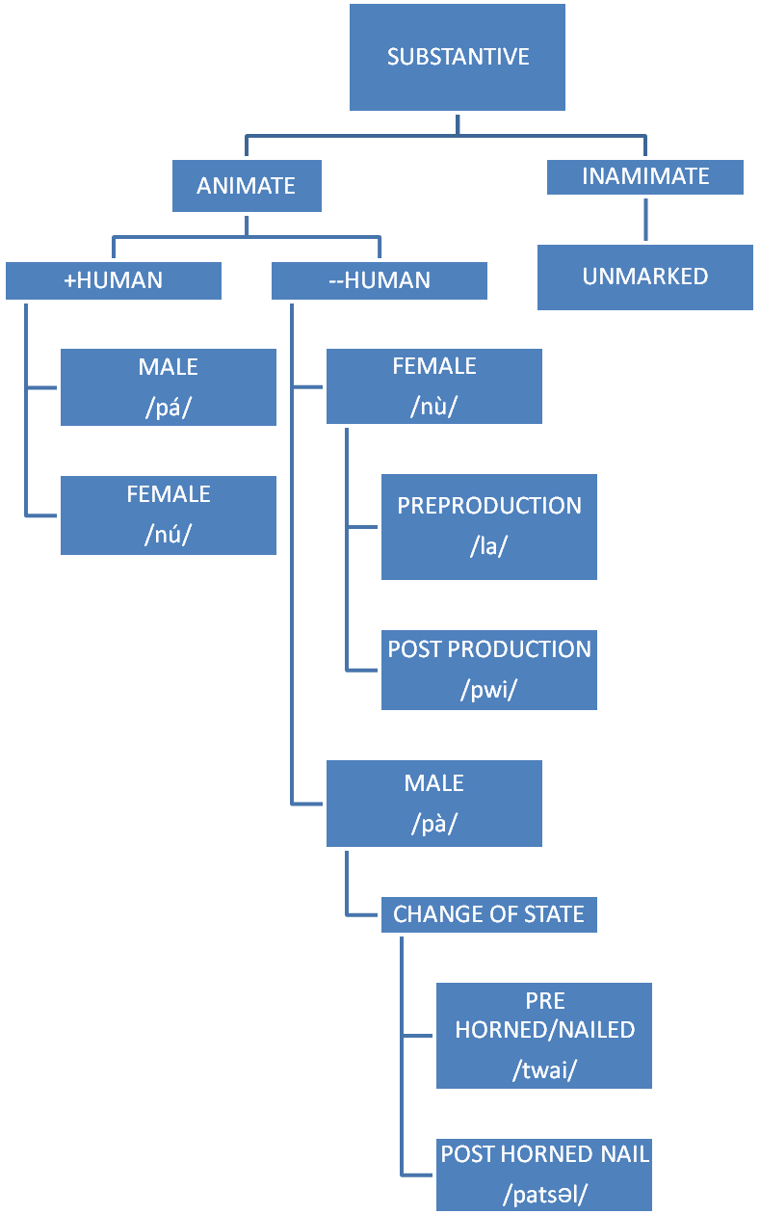
Tibeto-Burman Language Family System of Mizo
Notes:
Unique classifires tagin+ malto

Slide 5
Contd..
Classifier for human male is /pà̀`/. This is tonal language and that’s why tone distinction is very important.
Human Female classifier is /nu`/.
/pá/ and /nú/ are also words for father and mother respectively [with high tone].
For the common distinction between male and female animates, classifiers are /pà/ and /nù/ [with a falling tone] accordingly.

Slide 6
Contd...
Animate classifiers are also distinctive in case of change of state (reproductive stage and coming out of nail).
Horned animals like sheep, goat, and cow take the classifier /patʃəl/ with them.
II> /patʃəl/ is attached as a classifier to the animals having a nail at the back of leg (cock).
Classifiers are different in case of pre-reproduction and post reproduction stages for animates.

Slide 7
Contd.
Before reproduction male animate classifier is /twai/ and female is /la/. After reproduction they are /tʃəl/ and /pwi/ respectively.
For proper names there are distinction between male and their female counter parts. Classifier /-a/ is adjoined to male names and /-i/ with a female name.

Slide 8
contd
Human nouns occur with the classifier [mí].
For elongated objects like cigarette, bamboo, wood and battery [tlɔ:n] is used.
Round objects come with [púm]
Flat objects such as paper and plywood take [pʰe:k] as classifier.
For tree and flower classifiers are [ku:ŋ] and [pa:r] respectively.
[tʃi] is used to denote kind of things i.e. kind of stories etc.
Pieces of objects take the classifier [tʰém].

Slide 9
Contd..
For fruits, egg yolk, eye ball , orange seeds etc. [mú] is used as classifier
Food grains are referred by the classifier [fa:ŋ].
10. [zai] is used to denote small elongated objects like hair, wire , and thread
etc.

Slide 10
Contd..
Another interesting construction in the noun phrase can be seen for some nouns e.g. rice, water etc.
Buʔ pʰur kʰət
Rice CL-action of NUM (one)
carrying rice in a basket
One traditional basket of rice.
tui kɔt kʰət
Water CL: action of carrying NUM (one)
Water in two buckets with a bamboo pole
Two buckets of water

Slide 11
Tagin
N-[CL-NUM]
Head Noun – cl – Numeral
harpen – pen -riŋ
Half pant – cl – ten
‘Ten pairs of half pants’.
Numeral Classifier+ Noun= indefiniteness
modi di-kin
mountain CL -one
Demonstrative + Noun = definiteness
ho himi
that child (+ defnite)

Slide 12
Contd..
ta - TWO DIMENSIONAL OBJECTS
cə- ROUND SMALL OBJECTS:
so- LONG, CYLINDICAL OBJECTS:
da- NARROW OBJECTS:
bor- FLAT BROAD OBJECTS:
nɛ- REPRODUCTIVE ENTITIES:
pɯ:.- ROUND OBJECTS:
di- certain kind of elevation.

Slide 13
Contd.
Exception
Accept cow (hɛ) generally numeral classifiers are not used with animals. But when animals like mithuns and pig are used in the context of marriage ceremonies, they get the numeral classifiers.
Pigs when alive do not take numeral classifier. But sacrificed pigs take numeral classifier ma which is also a numeral classifier for dead-bodies (mentioned earlier).

Slide 14
Classifiers which map single entity and which are not formed through partial reduplication
rum :- t-shirt
spotiŋ rum----ɲi
t-shirt CL –two
sɛ:- cow
sɛ hɛ--ɲi
cow CL two
pom :– FLOWER
əpuŋ pom-riŋ
flower CL --one

Slide 15
Some facts about tagin numeral classifiers
Kitap camɲi (no numeral classifier is used)
Book twenty
Twenty books
Kitap camɲi gula dab-ɲi
Book twenty and CL-two
twenty two books

Slide 16
partial reduplication in tagin Classifiers
Pseudo Classifiers (Kidwai 2008)
a) harpen – half pants
harpen pen—riŋ
half pant CL —ten
ten half pants
(b) ma- dead bodies
səma ma—om
dead body CL –three
three dead bodies

Slide 17
Galo
[NOUN -NUM-CL+NUMERAL]
Numeral classifier [ho-] is used for long slender object.
pen ho-pi
Pen CL-Four
four pens
Classifier [pɑ] is used for things which are not very long, but fleshy and is covered.
fish : ŋoi
one fish : ŋoi pɑ-ken
CL-One

Slide 18
Contd..
Classifier [bor] is used for thin piece of cloth, a leaf or a piece of paper.
lɑlɯk bor-ʊm
Shirt CL-Three
Three Shirts
The numeral classifier for flat plank like objects is [tɑk-]. [tak-] is normally used with objects which has hard surface.
kʊŋke t̪ɑk-ken
Stool CL-One
One stool

Slide 19
Contd..
The numeral classifier [pɯ] is used objects which they consider to be round or circular.
pɯpə pɯ-ken
CL-One
an egg
lɑk Used for hands only
ɑlɑk lɑk-ken
Hand [CL]- One
‘mɑ’ for Dream, graveyard and boundaries
jʊmɑ mɑ-ʊm
Dream [CL]-Three
Three dreams

Slide 20
Contd..
‘Lo’ for day
ɑlo lo-ken
Day [CL]-One
One day
pom’ Bunch of ants, keys or flowers
t̪ɑrʊk pom-ɲi
Ants [CL]- two
Two ants
‘rɑp’ for door
ərɑp rɑp-ken
Door [CL]- One
One door
‘
‘

Slide 21
Contd..
‘ɡob’ Measurement with fingers.
lɑkcə ɡob-ken
Finger [CL]- One
spherical and thicker objects.
ɑbʊ bʊ-ken
River [CL]- One
nɑ [CL] for bags.
mʊnɑ nɑ-ken
Bag [CL]- One
Round and circular objects(medium sized)
pɯpə pɯ-kens
egg [CL]-One
Pinch of something
ɑlo ciŋ-ken
Salt [CL]-One

Slide 22
Dravidian family
Malto (Mahapatra ‘97)
Very interesting classification system.
Noun Phrase Structure: Numeral+ Classifier+ Noun
Animate entities are classified in to human and nonhuman.
tini jan maler
Three CLS men
Three men
tini maq bu:te
Three CLS ghosts
Three ghosts

Slide 23
Malto Classification
Objects
Discrete
Non discrete
dimensional
unique
shaped
Long
Flat
round
ɖaɽa
kaɽi
panda
paɽa
paʈa
pata
kanɖa
goʈ
pula

Slide 24
Contd..
There are some classifiers which are formed by Partial reduplication.
Applicable to restricted sets of Nouns.
qep- ‘village’; man- ‘tree’
Generalized construction
Classifier+ Numeral + Noun
qep-ond qepɖu
CLS-NUM village
Comapare Tagin
harpen – half pants
harpen pen—riŋ
half pant CL —ten
ten half pants

Slide 25
Contd..
State classifiers in Malto
baha: ---Area, field , market ,place
Ʈaɖa:-- small area
ɖika– clod , earth

Slide 26
Austro- Asiatic
Khasi (Numeral classifier language)
follows this pattern
Num Cls N
ŋut for classifying [+ human]
tɨlli for classifying [ -human]
Examples:-
a:r-ŋut ki-khɨnnaʔ
two cls Pl- Child
‘Two Children’

Slide 27
Contd
These classifiers can also be used as noun substitution provided the noun in question is an object of shared knowledge between the speaker and the hearer in a discourse.
la:y – tɨlli
three – cls ( - human )
three

Slide 28
Contd
Unlike other numeral classifier languages , the
numeral one ‘wei’ does not take any classifier. Instead, it is accompanied by the respective gender and agreement marker that the noun takes.
Example:-
u-wɛi u-ksɔw
msg-one msg-dog
‘ one dog’

Slide 29
Indo- Aryan
Assamese Classifier System
-zɔn - is used for 25 years and above male human, and with respect.
When -zɔn is not used for male human above about 25 yrs, and –tu/ -ta is used(different classifier discussed later), it shows disrespect for the person. Thus, a sense of +/- Honirificity can be seen here.
(Phookan, Dey, Lahiri, kaul 2008)

Slide 30
Contd…
for young girls, approximately 25 years and above; also when used with female person with 25 and above shows disrespect.
Eg. Noun CLA:
suvali-zoni
girl-CLA
-gɔraki - is used with female of 25 years and above, with respect :
Eg. noun CLA:
maiki- manuh-gɔraki
female human-CLA

Slide 31
Contd…
–zupa - is used with plants and trees :
aam-zupa
mango-tree-CLA
kʰɔn - is used for flat structured objects:
bisɔna-kʰɔn
bed-CLA
–dal - is used for branch like/stick like long objects :
suli-dal
hair-CLA
-kʰila - is used for leaves and pages :
pat-kʰila
leaf-CLA

Slide 32
Contd..
–zur - is used for pair of something we wear :
kʰela-sadɔr-zur
traditional dress-CLA
-hal - is used with pair of animates(except birds)
dɔra-kɔina-hal
bride and groom-CLA
–hali - is used with pair of sweet looking (from the observer’s point) birds :
sɔrai-hali
bird-CLA
dukʰɔr - is used for relatively bigger pieces of things :
mati-dukhɔr
soil-CLA

Slide 33
Contd..
–tukura - is used for relatively smaller pieces of things :
pitʰa-tukura
a type of cake-CLA
-tʰuka - is used for stack of fruits :
pʰal - is used for cut pieces of fruits and vegetables :
–pah - is used with flowers :
–pat - is used for flat structured object that is worn :

Slide 34
Contd..
–gosi - is used with cotton which is used to light a diya :
–tupal - is used with liquid drops :
bidʰ - is a taxonomic classifier; used with a kind/type of edible items
-kʰurak - is used with dose of medicine
-dɔra – is used with defined plot or area
–kusa - is used with lock of hair
mɔkʰa - is used for referring to a group of monkeys :

Slide 35
Contd..
tʰupa - is used with bunch of flowers
gal - is used for huge amount of items in derogatory sense :
. -gɔs - is used with ‘diya’(earthen lamps)
. –pal - is used to refer to a group of cows :
–zak - is used with a herd of cows and buffaloes :
–gusi - is used with betel leaf

Slide 36
Numeral classifiers : Assamese
Num CLA- Noun
ɛ- zoni suvali
one-CLA girl
One girl
ɛ- ta lora
One-CLA- boy
One boy

Slide 37
Final observations
Structure of Numeral Phrase
Construction 1:-- Num-cls noun
IA: Assamese, DA: Malto
Construction 2 :--Cls-Num-Noun:
DA: Malto (for numeral 1,2 and nonhuman nouns)
Constuction 3:- Noun cls-num:
TB: Mizo, Tagin, Galo

Slide 38
Contd..
Tibeto-Burman Family
MIZO:
System based on animacy
TAGIN:
no reference to humanness and animacy
Classifiers only for count nouns ([+QNT]).
Few nouns do not take numeral classifier (film, story, male etc..)

Slide 39
Contd…
Galo:
Classifiers based on shape, size and function.
Many of the classifiers are formed through partial reduplication which are considered to be pseudo classifiers.
No reference to animacy.
Khasi
No Numeral classifier is used with the cardinal one.
Instead it is accompanied by the respective gender and the agreement marker.

Slide 40
malto
Objects are classified along the lines of discreteness and Non discreteness.
Animates are classified into +/- Human
Some Classifiers are formed by partial reduplication

Slide 41
Assamese
Noun classifiers are determined along the lines of Animacy, Humanness, sex.
All + quantized Classifiers are movable to numeral.
Classifier raising is triggered by a [+QNT] and
[+definiteness] feature value.
lora-bur ‘the boys’
*tini-bur lora ‘3 boys’
kitaap- khan ‘the book’
tini-khan kitaap ‘3 books’
*tini-khini tel ‘3 oils’ {Oil is +Mass}

Slide 42
THANKS!! ☺

